Slide 1

The National University of Computer and Emerging Sciences
Sorting Arrays, Recursion
CS 1002 Programming Fundamentals
Dr. Akhtar Jamil
Department of Computer Science

Slide 2
Goals
Review Of Previous Lecture
Sorting Arrays
Recursion

Slide 3
Previous Lecture

Slide 4
Passing Arguments to Functions
c
Three ways to pass arguments to function:
Pass-by-value
Pass-by-reference with reference arguments
Pass-by-reference with pointer arguments

Slide 5
Using Reference Variables with Functions
c
To create a second name (Alias) for a variable in a program
A variable that acts as an alias for another variable is called a reference variable, or simply a reference
Arguments passed to function using reference arguments:
Modify original values of arguments

Slide 6
1. Pass by Reference– Example
c
void AddGraceMarks(int &marks) { cout<<“\nActual marks:"<<marks<<endl; marks = marks + 10; cout<<“\nMarks Updated to:"<<marks<<endl; } int main() { int marks = 75; AddGraceMarks(marks); cout<<“You marks in PF are: ”<<marks<<endl; return 0; }

Slide 7
Passing an Array to a Function
An int array
c
int Display(int data[], int N) {
cout<<“Array contains”<<endl;
for (int k=0; k<N; k++)
cout<<data[k]<<“ “;
cout<<endl;
}
int main( )
{
int a[4] = {11, 33, 55, 77};
Display(a, 4);
return 0;
}
The size of the array
The array argument, no [ ] or & symbol

Slide 8
Today’s Lecture

Slide 9
Sorting An Array
Sorting: Arranging values of an array in Ascending or Descending order.
E.g., 65, 34, 12, 7, 5, 2, 1 {Descending order}
3, 13, 23, 37, 49, 87 {Ascending order}
Bubble Sort
• Repeatedly stepping through the array to be sorted, comparing each pair of adjacent items and swapping
them if they are in the wrong order. The pass through the array is repeated until no swaps are needed (which indicates that the list is sorted)

Slide 10
Sorting An Array(Ascending) (bubble sort)

Slide 11
Sorting An Array(Ascending)
int a[10]={33,10,1,87,6,44,23,3,11,82};
int i,j,temp;
int N=10;
for (i=0; i<N; i++)
{
for (int j=0; j<N-1-i; j++)
if (a[j] > a[j+1])
{ temp = a[j];
a[j] = a[j+1];
a[j+1] = temp;
}
}

Slide 12
Sorting An Array(Descending)
int a[10]={33,10,1,87,6,44,23,3,11,82};
int i,j,temp;
int N=10;
for (i=0; i<N; i++)
{
for (int j=0; j<N-1-i; j++)
if (a[j] < a[j+1])
{ temp = a[j];
a[j] = a[j+1];
a[j+1] = temp;
}
}

Slide 13
Memory Mayout

Slide 15
Call Stack

Slide 16
Call Stack
Stacks are last-in, first-out (LIFO) data structures
The last item pushed (inserted) on the stack is the first item popped (removed) from it.
Important for C++ `programs.
Supports the function call/return mechanism
Creation, maintenance and destruction of each called function's automatic variables

Slide 17
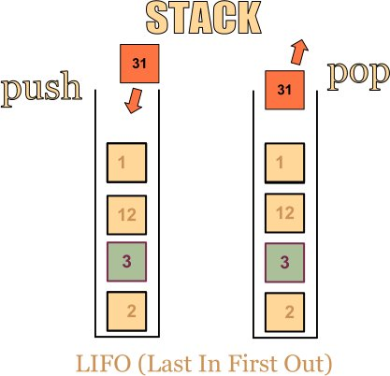
Call Stack
Each time a function is called, an entry is pushed onto the stack.
Stack frame
Stack Frame stores
The return address
Automatic (local) variables.

Slide 18
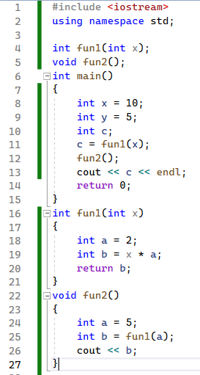

Slide 19
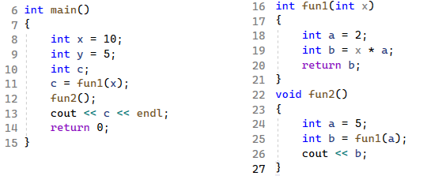

Slide 20
Recursion

Slide 21
Introduction to Recursion
A recursive function is one that calls itself.
void Message(void) { cout << "This is a recursive function.\n"; Message(); }
The above function displays the string "This is a recursive function.\n", and then calls itself.
Can you see a problem with this function?

Slide 22
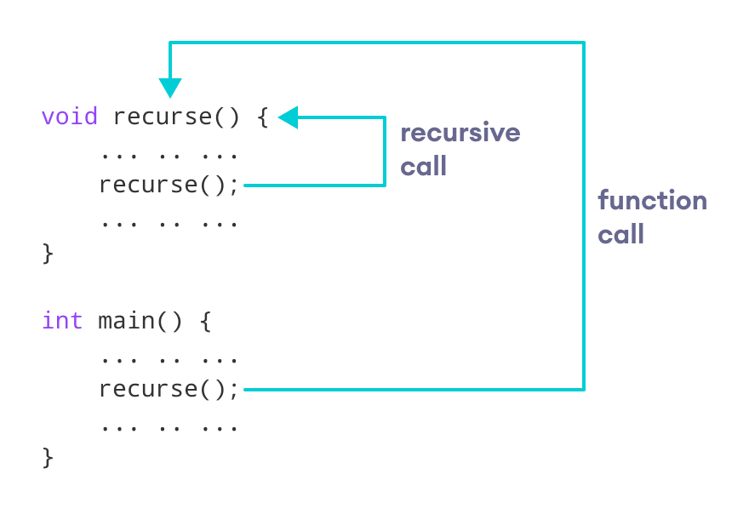
Introduction to Recursion

Slide 23
Recursion
The function is like an infinite loop because there is no code to stop it from repeating.
Like a loop, a recursive function must have some algorithm to control the number of times it repeats.

Slide 24
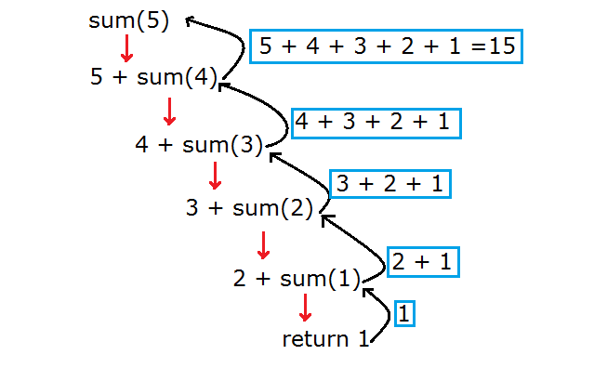
Example: Sum numbers using Recursion
sum(10) = 10+9+…2+1 = 55

Slide 25
Creating a Sum function (Iterative)
//Our initial total is zero
int total = 0;
//We want the sum from 1 + 2 + ... + 9 + 10
int n = 10;
/* The following for loop will calculate the summation from 1 – n */
for ( int i = 1; i <= n; i++ ) {
total = total + i;
}

Slide 26
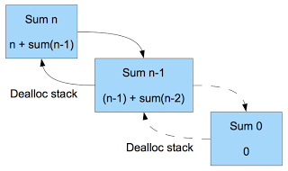
Example: Sum numbers using Recursion
int sum(int n) {
//Return 0 when n is 0
if ( n ==1 )
return 1;
else //recursive call
return n + sum(n-1);
}

Slide 27
Recursion : Using Control Condition
void Message(int times) { if (times > 0) { cout << "This is a recursive function.\n"; Message(times ‑ 1); } return; }
The function contains an if/else statement that controls the repetition. For example, if we call the function:
Message(5);
The argument, 5, will cause the function to call itself 6 times.

Slide 28
Recursion : Using Control Condition
void Message(int times) { if (times > 0) // Base case { cout << "This is a recursive function.\n"; Message(times ‑ 1); } return; }
With each recursive call, the parameter controlling the recursion should move closer to the base case
Eventually, the parameter reaches the base case and the chain of recursive calls terminates

Slide 29
void Message(int times) { if (times > 0) { cout << "This is a recursive function.\n"; Message(times ‑ 1);
} return; }
1st call of the function
Value of times: 5
2nd call of the function
Value of times: 4
3rd call of the function
Value of times: 3
4th call of the function
Value of times: 2
This cycle repeats itself until 0 is passed to the function.
5th call of the function
Value of times: 1
6th call of the function
Depth of recursion: 6
Value of times: 0

Slide 30
Program Output
This is a recursive function. This is a recursive function. This is a recursive function. This is a recursive function. This is a recursive function.

Slide 31
What Happens When Called?
Each time a recursive function is called, a new copy of the function runs, with new instances of parameters and local variables being created
As each copy finishes executing, it returns to the copy of the function that called it
When the initial copy finishes executing, it returns to the part of the program that made the initial call to the function
Notes:
See pr14-03.cpp

Slide 32
References
Credit goes to Dr. Muhammad Aleem for preparation of slides
Chapter 20, Starting out with c++

Slide 33
Thank You ☺

